Slide 2
Manifest Destiny
8th Grade U.S. History

Slide 3
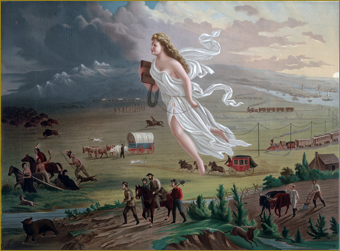
American Progress by John Gast, 1872
Notes:
John Gast, American Progress, 1872. Chromolithograph published by George A, Crofutt. Prints and Photographs Division, Library of Congress. Retrieved from: https://upload.wikimedia.org/wikipedia/commons/f/fd/American_Progress_%28John_Gast_painting%29.jpg

Slide 4
American Progress by John Gast, 1872
1
2
3
4
Notes:
John Gast, American Progress, 1872. Chromolithograph published by George A, Crofutt. Prints and Photographs Division, Library of Congress. Retrieved from: https://upload.wikimedia.org/wikipedia/commons/f/fd/American_Progress_%28John_Gast_painting%29.jpg

Slide 5
Essential Questions
How was the concept of manifest destiny used to motivate and justify U.S. territorial expansion?
How did manifest destiny impact multiple groups of people differently?

Slide 6
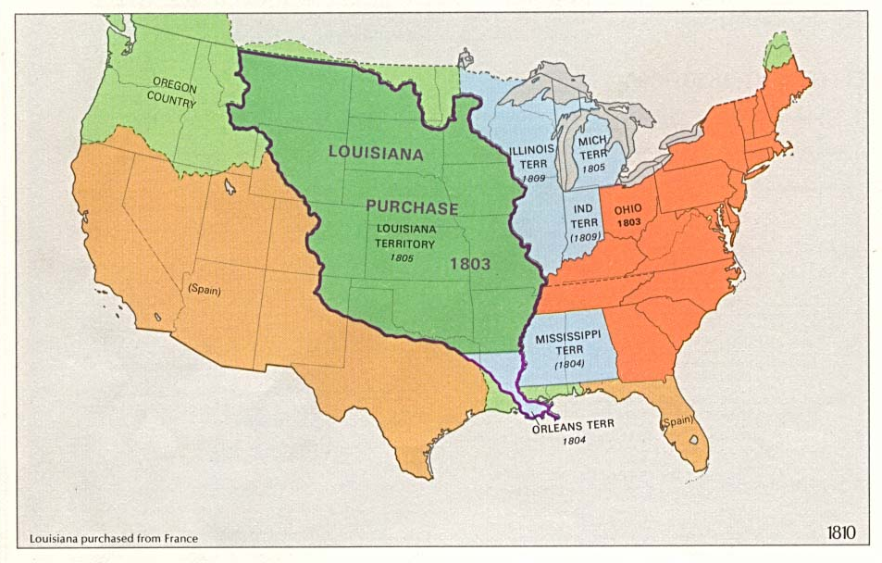
U.S. 1810
Notes:
U.S. Territorial Growth Map 1810. The National Atlas of the United States of America (Arch C. Gerlach, editor). Washington, D.C.:U.S. Dept. of the Interior, Geological Survey, 1970. Retrieved from: https://www.gifex.com/fullsize-en/2009-09-18 8526/United_States_Territorial_Growth_Map_1810.html

Slide 7
Manifest Destiny is...

Slide 8
Manifest Destiny is...
a 19th century belief that the United States had the right or duty to expand across the North American continent to the Pacific Ocean spreading American culture and democratic government.
a belief used to both motivate and justify American expansion.

Slide 9
Discussion Question
How did the United States use the idea of Manifest Destiny to motivate and justify their expansion into land that was already occupied?

